Slide 1
Title
Troy Strunks

Slide 2
Introduction
A great opportunity to lean how to design and build prototypes of automated smart home and security systems. This included beginning with a digital model using Tinker cad, then using the tech core kit to build the hardware and then following up with writing the program in Arduino IDE.
The automated smart home and security systems I designed consisted of several components. First a door sensor which monitored whether a door was open or not, this could be applied to windows or gates as well.
Next was a distance sensor, which was used to detect movement. Allowing users to track if there is someone moving about.
Next was an automated light which would come on when dark. This could be used for outside lights to illuminate a perimeter at dark, or inside as a part of a backup system turning on emergency lights if the main power when out.
Next was included a water level sensor. This is great for low land areas that may be prone to flooding. Or for animal troughs to maintain water. Or for pumps that need to maintain a consistent level.
Finally, was included a temperature and humidity sensor. This is great for being able to connect to a thermostat to regulate internal temperature, or to adjust vents and fans to adjust humidity or even humidifiers of dehumidifiers if needed.

Slide 3
Circuit Simulation in Tinkercad

Slide 4
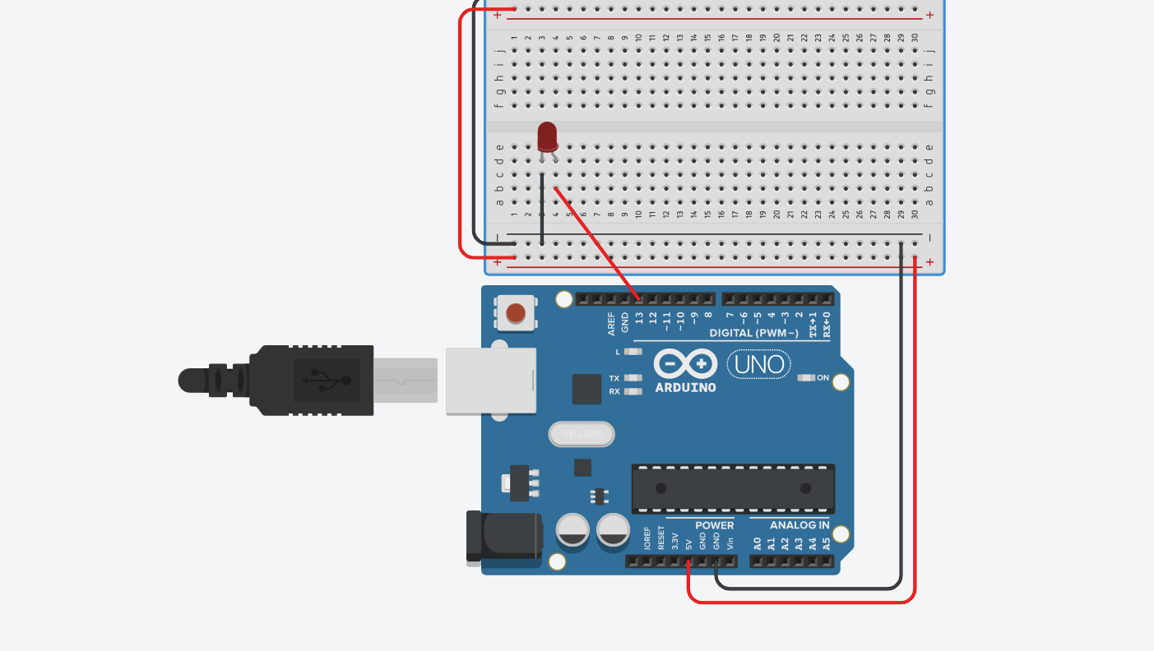
Circuit

Slide 5
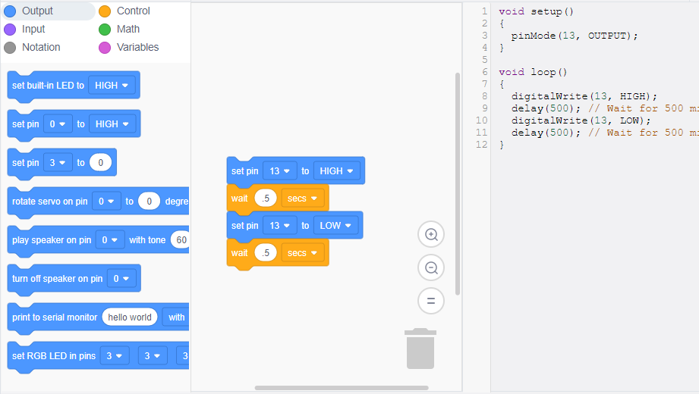
Code

Slide 6
Inventory of Parts, Circuit Building, and Displaying Messages

Slide 7
Inventory of IoT Kit
UCTRONICS Kit
ESP32 (2)
LCD Modules (2)
Breadboards (3)
Mini Router
Patch Cable
Digital Multi Meter
USB to Micro USB (2)

Slide 8
Organization of Project Components
Arduino Mega 2560
Breadboard
Resistor 10kΩ
LEDs
Ultrasonic Sensor
Active Buzzer
Photoresistor
Wires
USB Type B cable

Slide 9
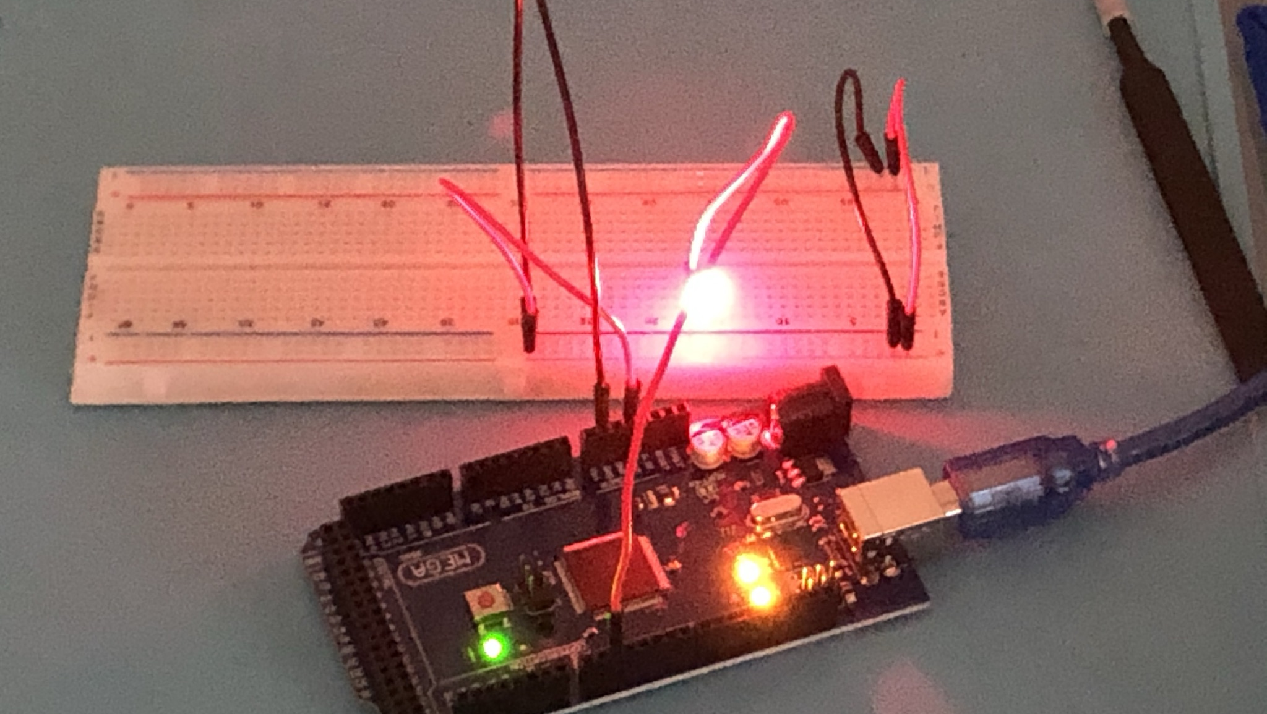
Circuit with red LED on

Slide 10
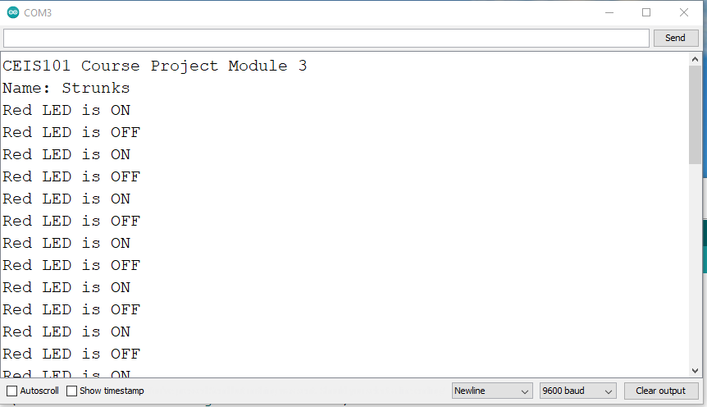
Serial Monitor

Slide 11
Adding Door Sensor to Smart Home System

Slide 12
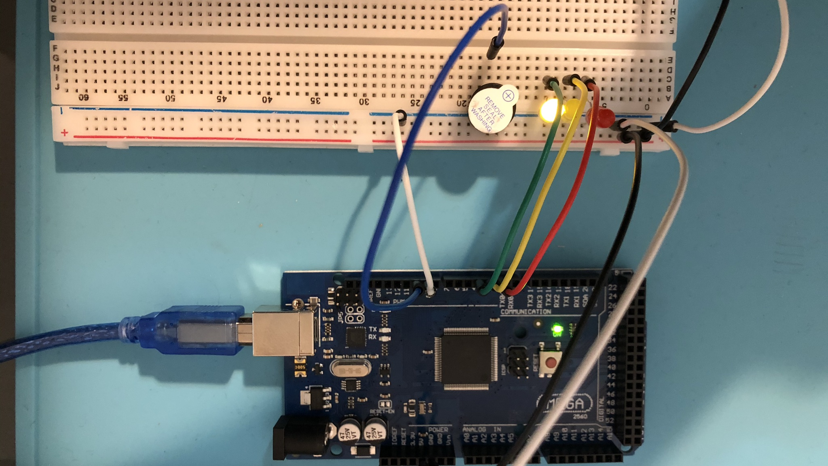
Circuit of door closed with Green LED ON

Slide 13
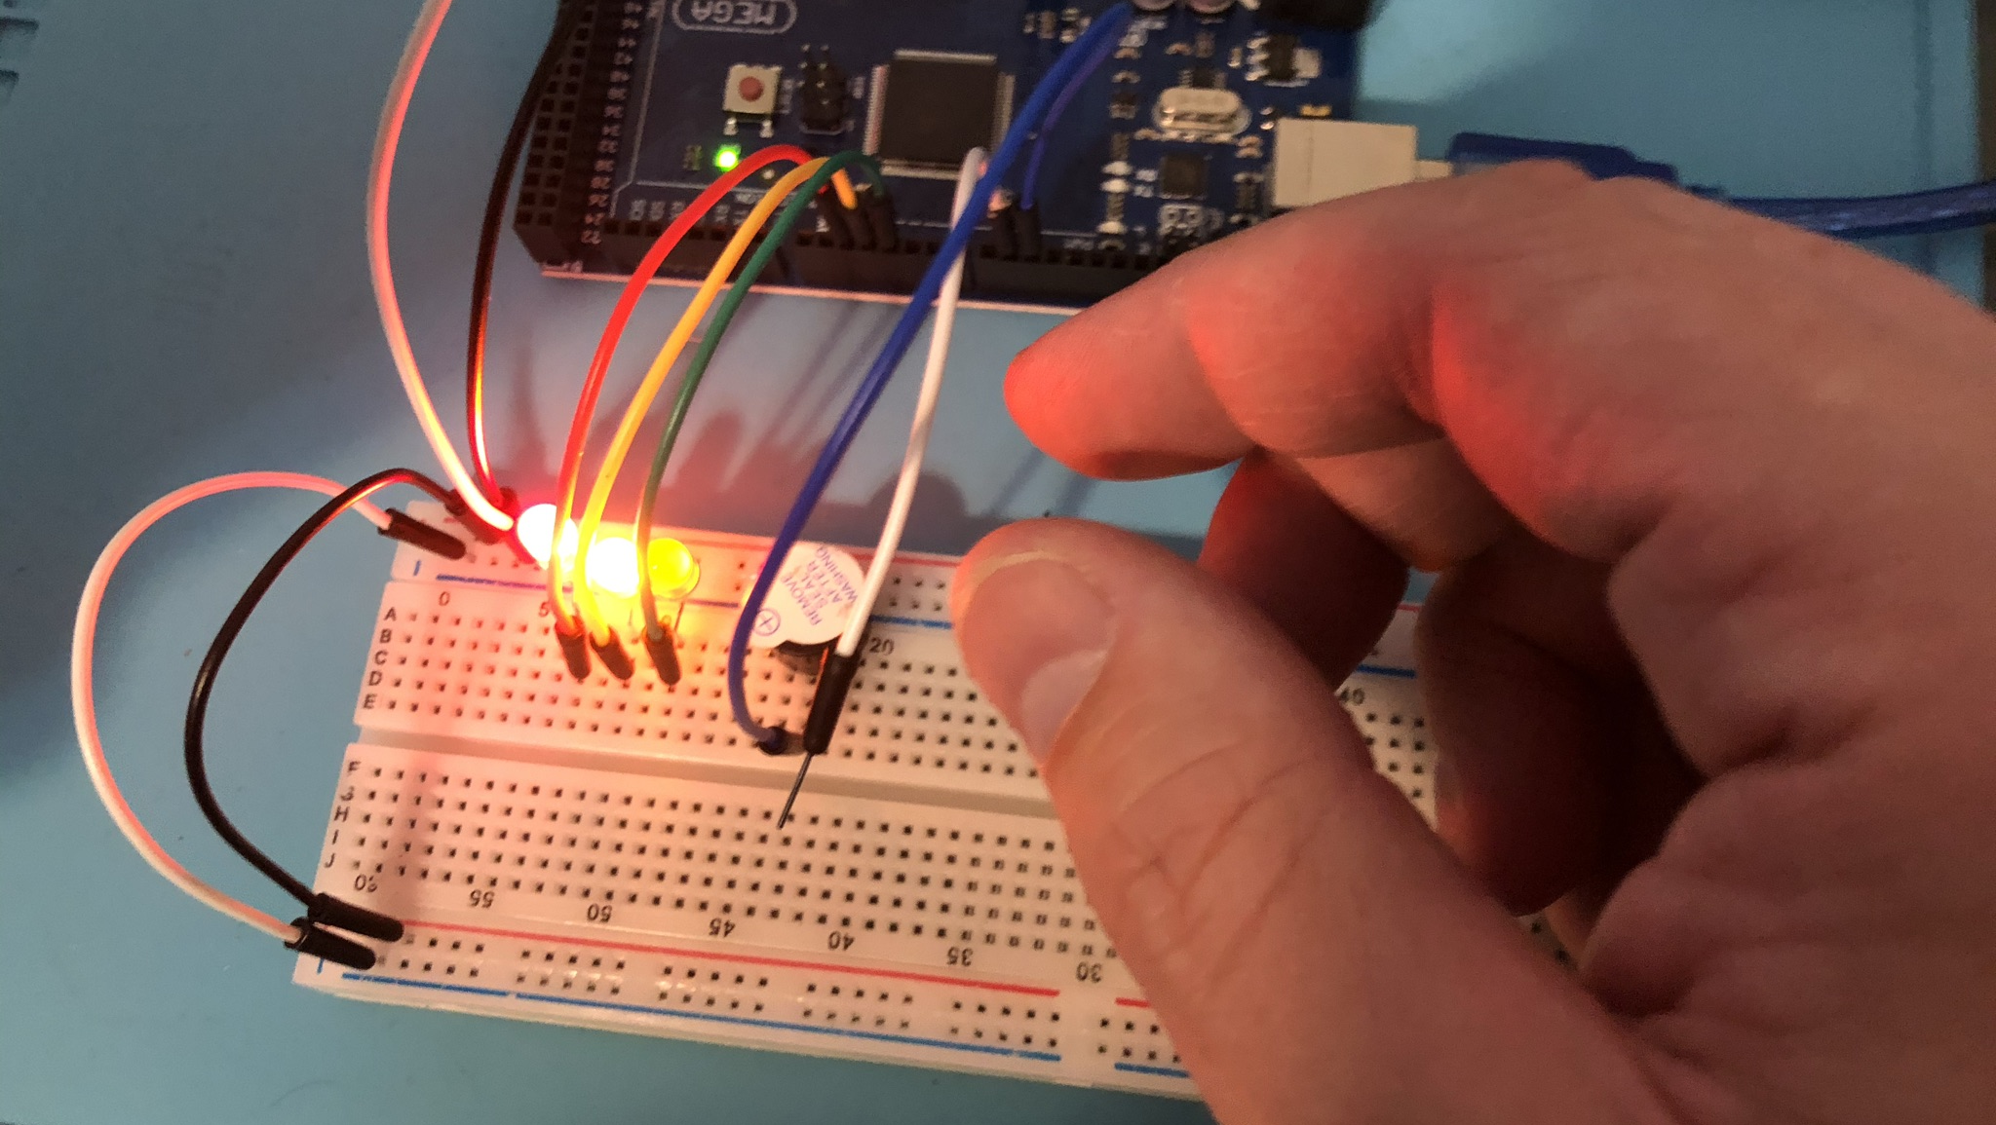
Circuit of door open with Green LED OFF

Slide 14
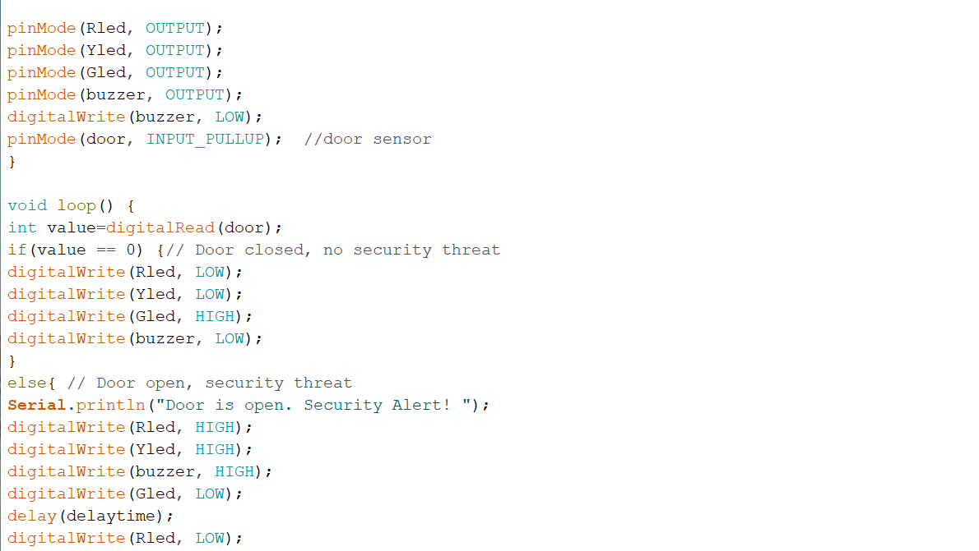
Arduino Code

Slide 15
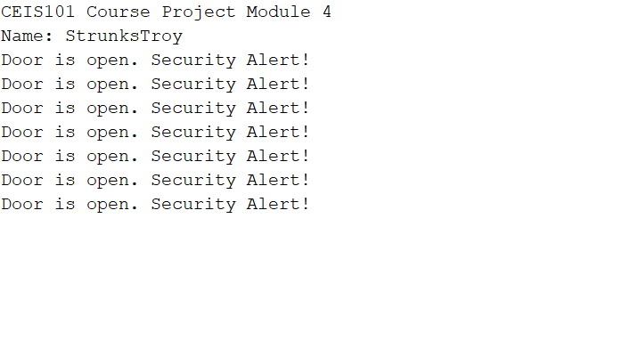
Serial Monitor (screenshot)

Slide 16
Adding Distance Sensor to Smart Home System and Conducting Data Analysis

Slide 17
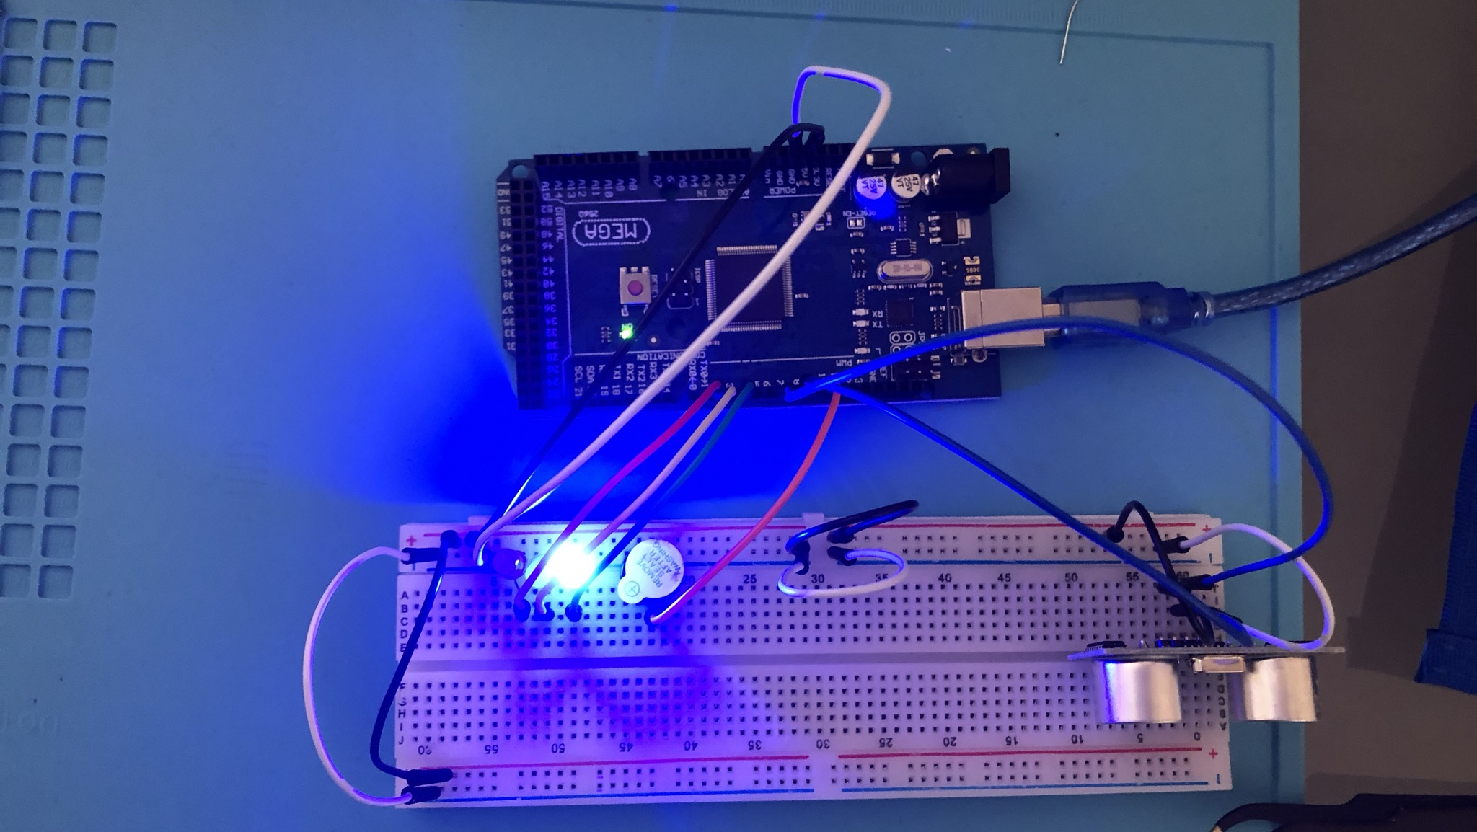
Circuit with green LED on

Slide 18
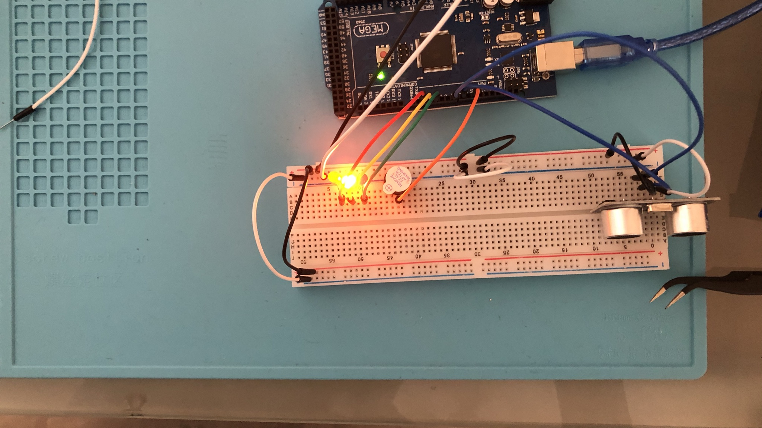
Circuit with yellow LED on

Slide 19
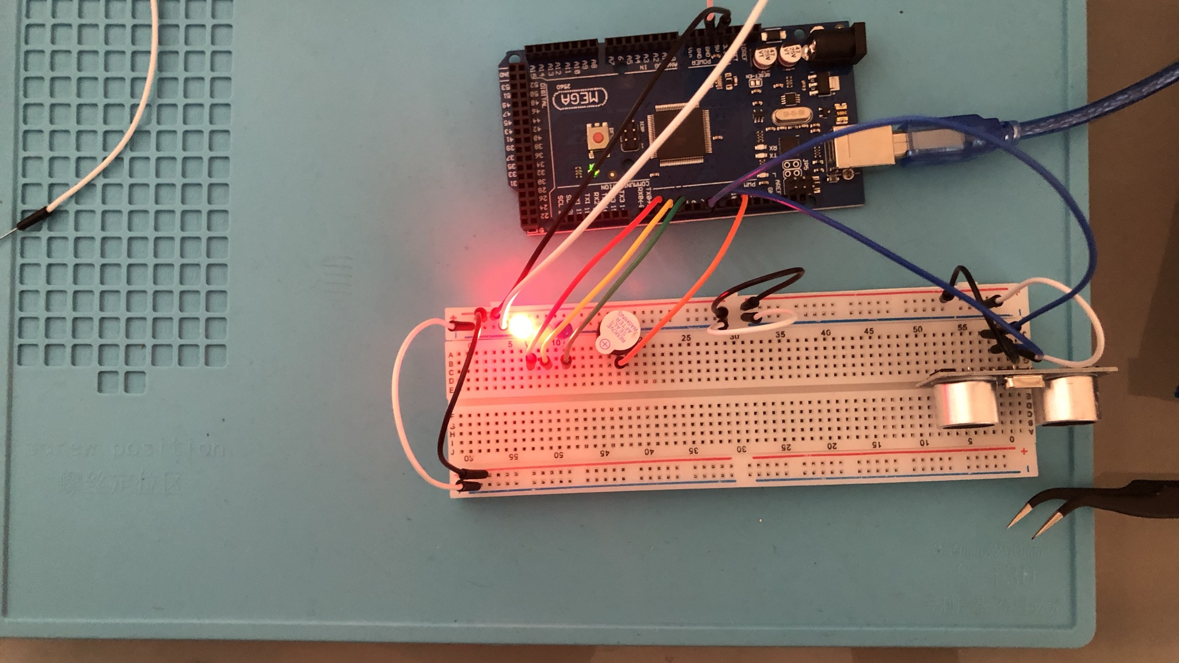
Circuit with red LED on

Slide 20
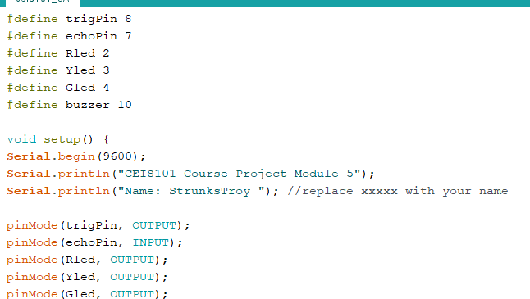
Arduino Code

Slide 21
Plot of data

Slide 22
Adding Automated Light to Smart Home System

Slide 23
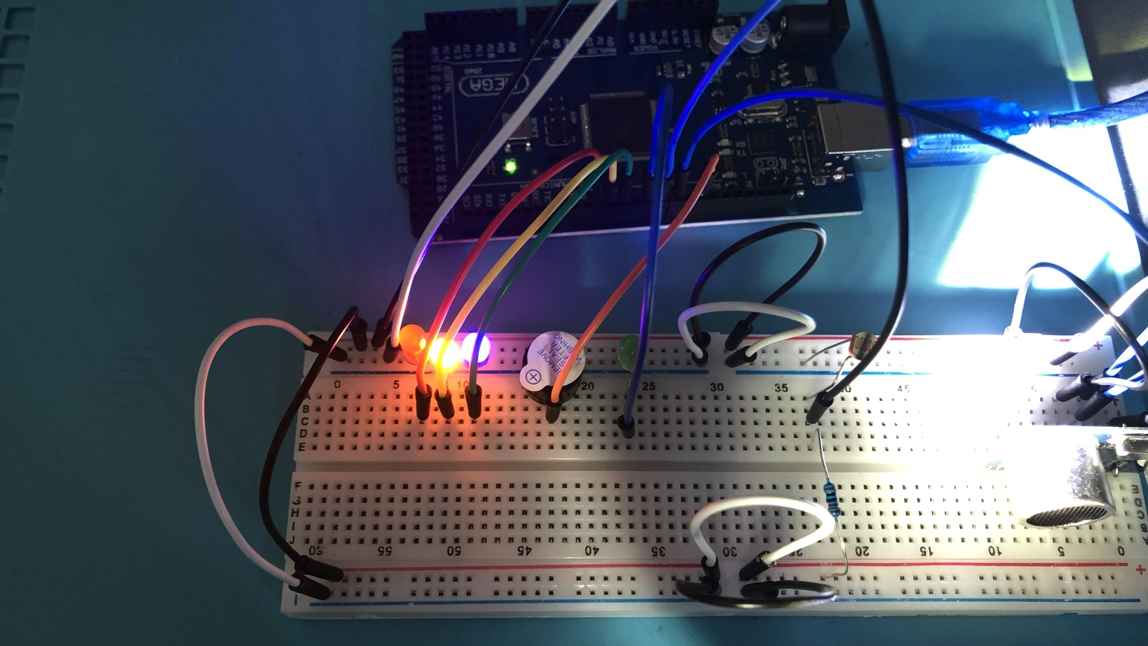
Circuit with automated LED off

Slide 24
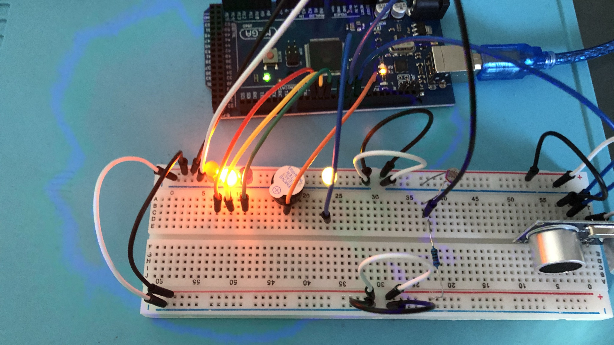
Circuit with automated LED on

Slide 25
Arduino Code

Slide 26
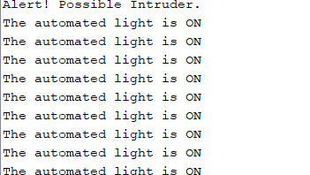
Serial Monitor

Slide 27
Challenges
The first challenge I encounter was having a power issue with my board. I burned out the first three bulbs.
Second challenge was working with 2 different types of bread boards, one being split, so having to figure that out and wiring the two sides of the board together.

Slide 28
Career skills
Developing knowledge with hardware and the physical devices
Learning the basics about IOT and its implication across many types of devices.
Operating system fundaments and learning how manage code to control IOT devices.
Discovering the business application of IOT. All the different ways and with how many different types of device that IOT becomes applicable.
Working with data received from sensors.
Developing a introductory understanding of securities. The needs and areas of weakness.

Slide 29
Conclusion
It was a great experience to develop an introductory knowledge of IOT and its diverse application. Opens to mind to many different directions that this path could take someone, including areas that are not commonly thought of as IT fields.
To be able to see a project from start to finish. The planning, the physical prototype, the coding, and the sensor output, really gives a clearer understanding. Makes the knowledge less abstract feeling and becomes applicable.

